Slide 1
Multilingual support – Arabic & Bangla

Slide 2
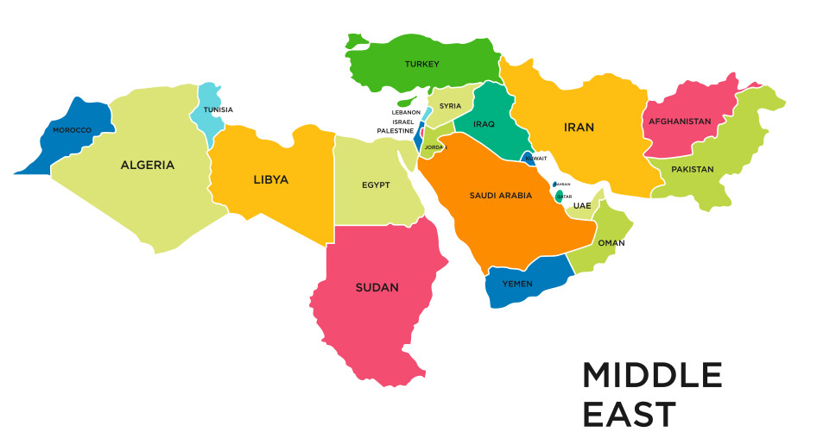
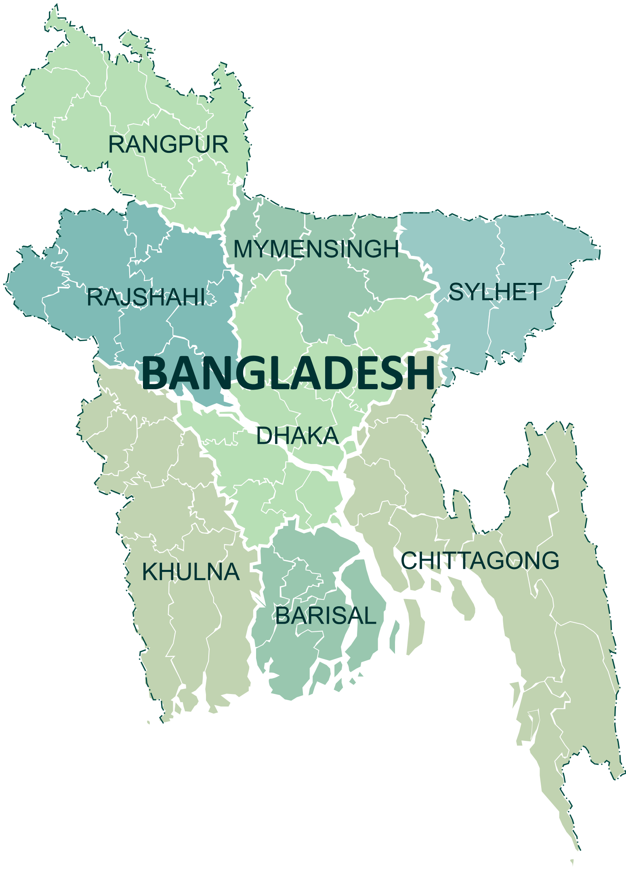
Enhancement – Supporting TallyPrime in Arabic & Bangla languages

Slide 3
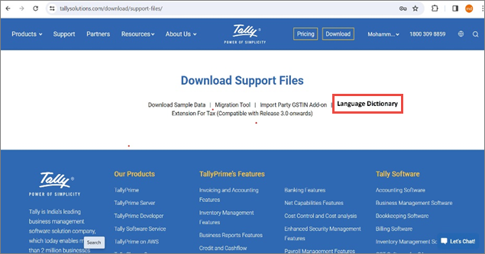
Product configuration – How to change the language?
1
Upgrade to TallyPrime 5.0 release
2
Download the language file from Tally website
tallysolutions.com/download/support-files/

Slide 4
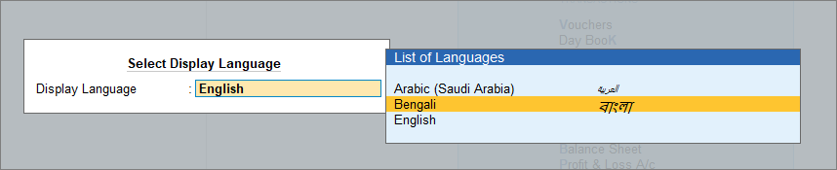
Product configuration – How to change the language?
3
Copy the downloaded file inside the “LANG” folder of TallyPrime
4
Select the “Display language” in TallyPrime
Gateway of Tally > F1 (Help) > Settings > Language > Ctrl+K (Display Language).

Slide 5
Product configuration – How to change the language?
5
You will be able to see the application display language changed
6
You can now print the invoice in respective display language as well
Few branded names like TallyShop, TallyHelp, TallyPrime Silver/Gold, TDL names will still display in English.
7
Customer can change the data entry language so that he can create masters & transcations in required languages.
8

Slide 6
Outstanding Management– Sorting of Bills

Slide 7
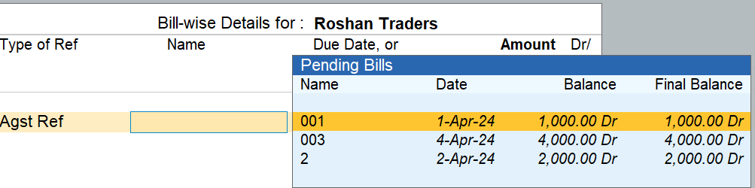
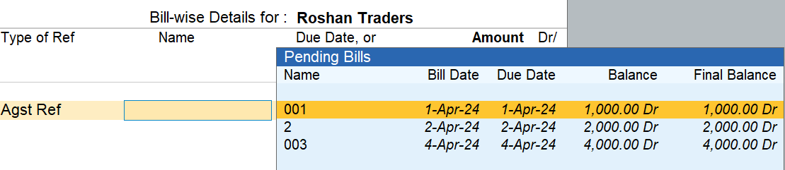
Sorting of Bills
Existing Behavior
New Behavior
Bills are sorted based on Bill name
Bills can be now sorted based on Bill date, Bill name, Due Date, Balance, Bill reference name or final balance

Slide 8
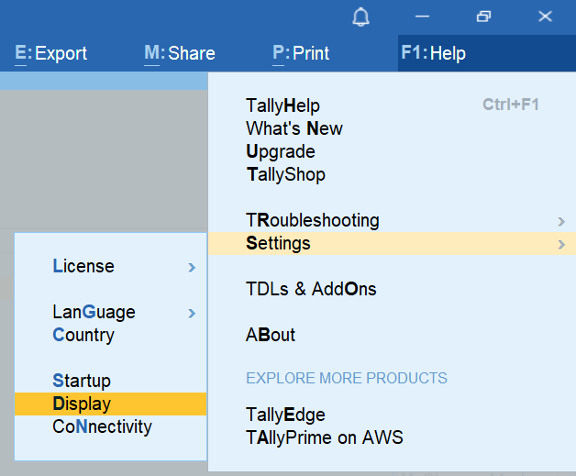
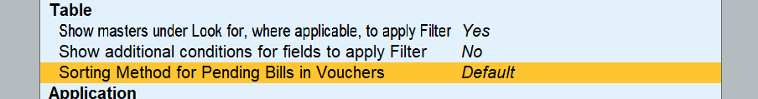
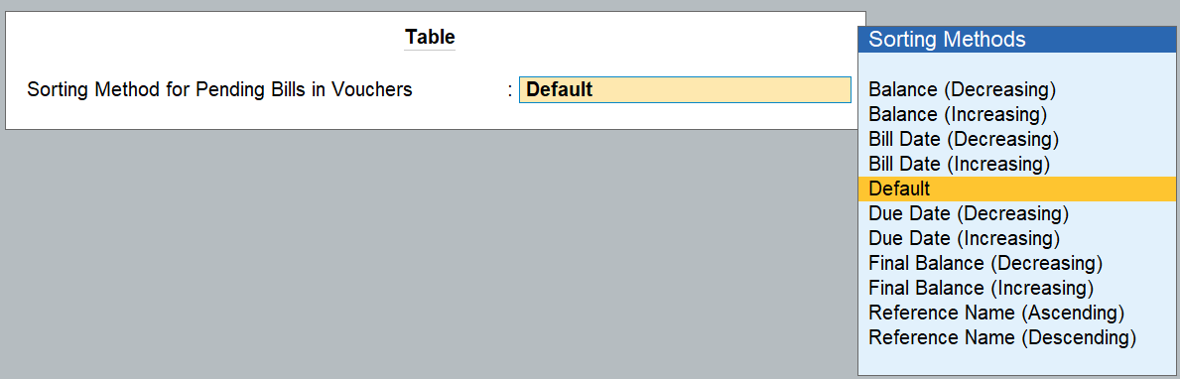
How to configure sorting view in 5.0?
Vouchers

Slide 9
Sorting of Bills – Enhancement objective
Easy view
Bills sorting based on due dates will ease to clear the bills in FIFO basis
Avoid interest on late payments
Helps businesses to avoid interest charged by suppliers on the late payments
To avoid late fee
If the due dates are missed especially for MSME, the late fee or penalty is levied. This feature helps in prioritizing the payments

Slide 11

Sorting of Bills - Points to note
When the data is migrated to TallyPrime Release 5.0, by default the sorting is set to “Default” behavior, which means bills will sort based on Bill name
Once configured in F1, it applies to all the companies

Slide 12
MIS reports – Stripe view

Slide 13
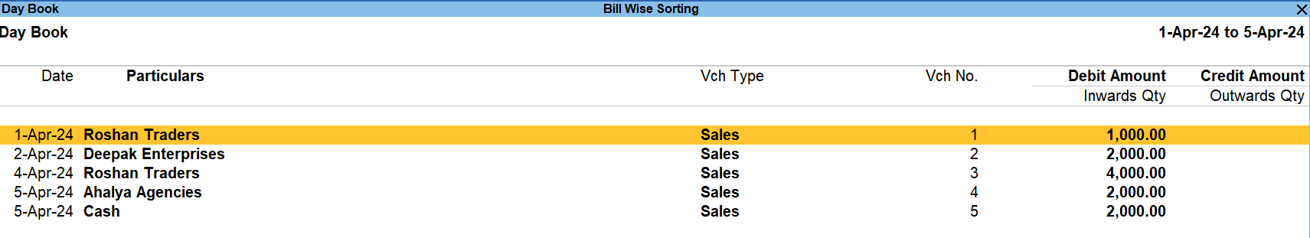
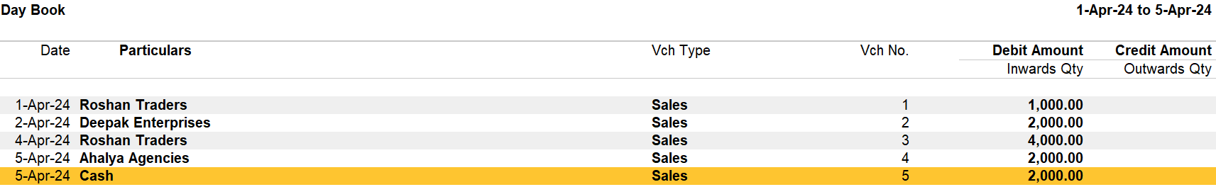
What is Stripe View?
Stripe view provides the clear visibility of the data represented as each line item is presented individually
Till 4.1
5.0 & above

Slide 14
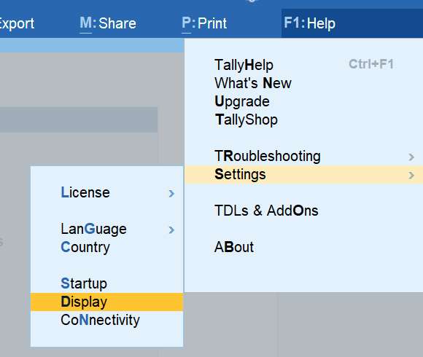

Stripe View – How to configure?
Applicable for Vouchers & Reports
For across all the companies
1
2

Slide 15
Stripe View – How to configure?
For specific company & specific to Reports or Vouchers
Press F12 in any Report & Voucher

Slide 16
Stripe view - Points to Note
Stripe view is supported in Vouchers & Reports
Vouchers & Reported can be printed with Stripe lines
Export, E-mail & WhatsApp is supported
Stripe view configuration is included in “Save view”
Stripe view is supported in Voucher display mode
Export file format supported – PDF & JPEG only
Dot matrix is not supported, will be taken up in future release

Slide 17
Stripe view – Points to Note
Below areas will not be impacted
Any E-returns
Post activity summary reports -
Tables & sub-forms like
Bill allocations
Item allocation
F12 configuration
Top menu options
Supplementary details, etc
Migration summary
Repair summary
Message box or warning messages

Slide 18


Is Stripe view = Grid lines
Stripe lines are used for Highlighting the data points , usually appears as shades.
Grid lines adds the lines to create a grid form

